Slide 1

CS233: Software Engineering and Project Management
Computer Science and Engineering
S.Y. Semester III
2022-23

Slide 2
CS233:Software Engineering and Project Management
Examination Scheme :
Continuous Assessment: 60 Marks End Semester Examination :40 Marks Credit:3+1=4
Course Objectives:
1.Knowledge:
a. To understand the Software Development and Software Lifecycle Process model.
b. To understand and learn different software modeling techniques.
2. Skill:
a. To understand and analyze the project management principle for software
development.
b. To evaluate the system functionality using testing.
3. Attitude:
a. To be able to understand new trends and methods in User Experience Design.
Course Outcomes:
1. Analyze process models and its appropriate selection for Development of Software Projects.
2. Use software design methods and principles for real world applications.
3. Understand and apply Project Management Principles using appropriate tool.
4. Choose modern tools for Software Development and Project Management.

Slide 3
Guidelines for SEPM
Class Continuous Assessment (CCA): 60
Lab Continuous Assessment (LCA): 50
Term End Exam: 40

Slide 4
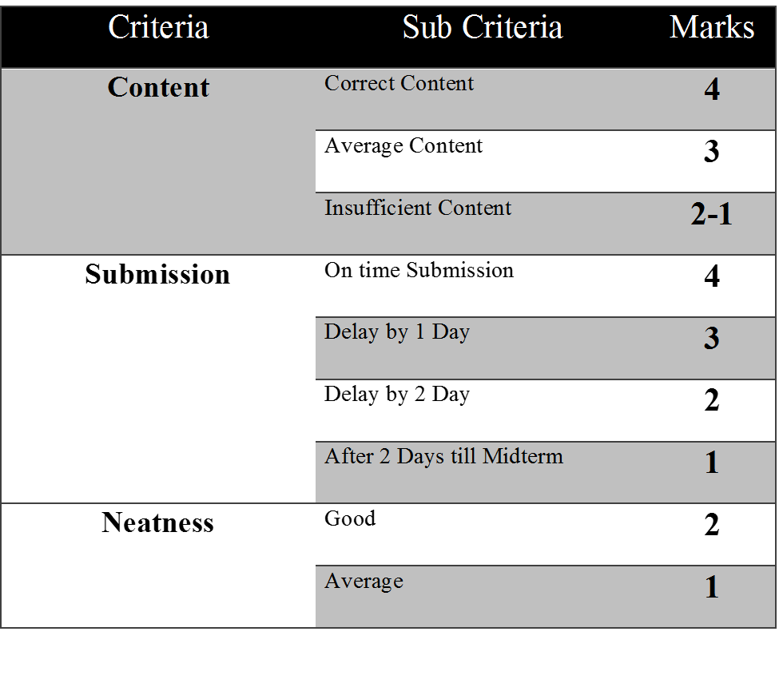
CCA Marks
Exam | Weightage | Marks
Mid-Term | 33% | 20
Presentation | 25% | 15
Theory Assignment | 25% | 15
Case Study/Active Learning | 17% | 10

Slide 5
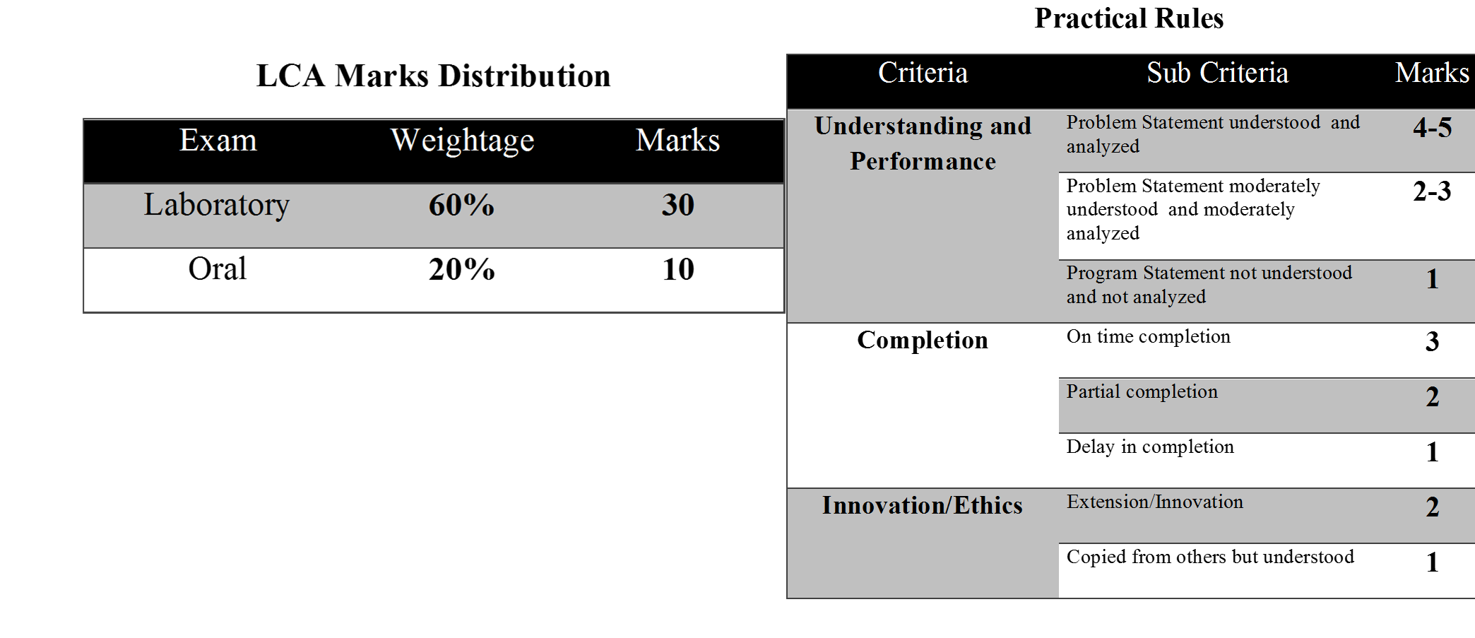
LCA Marks
LCA Marks Distribution
Exam | Weightage | Marks
Laboratory | 60% | 30
Oral | 40% | 20

Slide 6
Unit 1. SOFTWARE PROCESS
Introduction to Software Engineering
Importance of Software Engineering
Software Engineering Practice , Software Myths
Software Process, Software Perspective and Specialized Process Models.
Case Studies
Software Requirements, User requirements, System requirements
Software Requirements Specification
Functional Specification and Non-functional specifications
Disclaimer:
Information included in this slides came from multiple sources. We have tried our best to cite the sources. Please refer to the References to learn about the sources, when applicable.
The slides should be used only for academic purposes (e.g., in teaching a class), and should not be used for commercial purposes.

Slide 7
What is Software?
Software is: (1) instructions (computer programs) that when executed provide desired features, function, and performance; (2) data structures that enable the programs to adequately manipulate information and (3) documentation that describes the operation and use of the programs.
The IEEE definition of Software Engineering
Software Engineering: (1) The application of a systematic, disciplined, quantifiable approach to the development, operation, and maintenance of software; that is, the application of engineering to software. (2) The study of approaches as in (1).
Without software, most computers would be useless. For example, without your internet browser software, you could not surf the Internet or read this page.
Without an operating system, the browser could not run on your computer

Slide 8
Software
How do you get software?
Software can be purchased at a retail computer store or online and come in a box containing all the disks (floppy diskette, CD, DVD, or Blu-ray), manuals, warranty, and other documentation.
Software can also be downloaded to a computer over the Internet. Once downloaded, setup files are run to start the installation process on your computer.
Free software : There are also a lot of free software programs available that are separated into different categories.
Shareware or trial software is software that gives you a few days to try the software before you have to buy the program. After the trial time expires, you'll be asked to enter a code or register the product before you can continue to use it.
Freeware is completely free software that never requires payment, as long as it is not modified.
Open source software is similar to freeware. Not only is the program given away for free, but the source code used to make the program is as well, allowing anyone to modify the program or view how it was created.

Slide 9
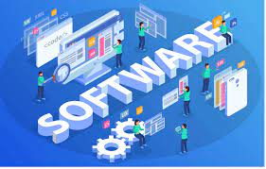
Examples
Software | Examples
Antivirus | AVG, Housecall, McAfee, and Norton.
Audio / Music program | iTunes and WinAmp.
Database | Access, MySQL, and SQL.
Device drivers | Computer drivers.
E-mail | Outlook and Thunderbird.
Game | Madden NFL football, Quake, and World of Warcraft.
Internet browser | Firefox, Google Chrome, and Internet Explorer.
Movie player | VLC and Windows Media Player.
Operating system | Android, iOS, Linux, macOS, and Windows.

Slide 10
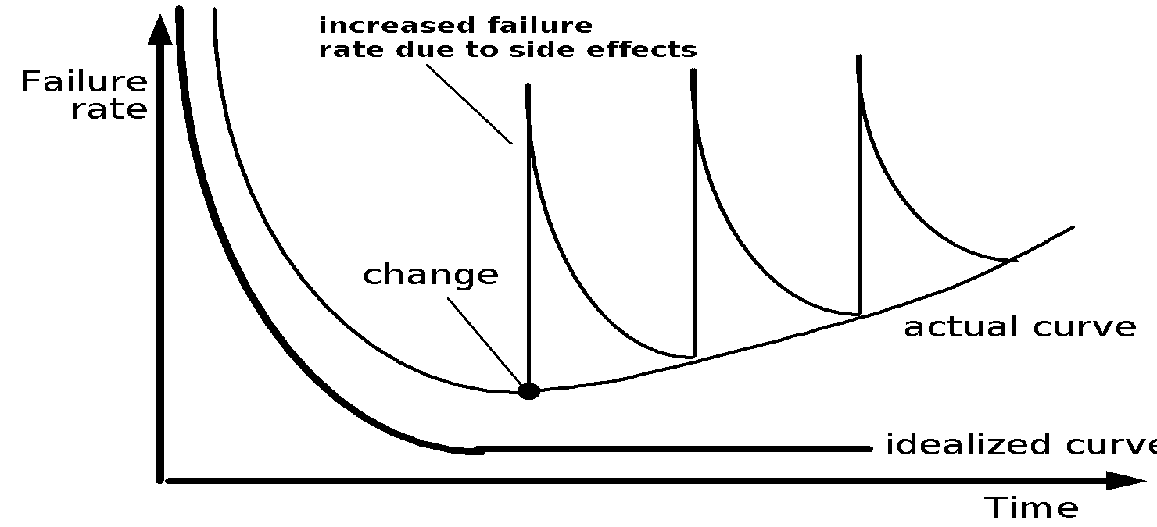
Importance of Software
Software is developed or engineered, it is not manufactured in the classical sense.
Software doesn't "wear out."
Although the industry is moving toward component-based construction, most software continues to be custom-built.

Slide 11
Software Applications
1. System software: System software serves as the interface between the hardware and the end users.
Some examples of system software are Operating System, Compilers, Interpreter, Assemblers, etc.
2. Application software: e.g. Payroll Software, Student Record Software, Inventory Management Software, Income Tax Software, Railways Reservation Software, Microsoft Office Suite Software, Microsoft Word
3. Engineering/scientific software: e.g. CAD/CAM, automatic stress analysis, nuclear biology, Space shuttle
4.Embedded software: Embedded software is a piece of software that is embedded in hardware or non-PC devices. It is written specifically for the particular hardware that it runs on and usually has processing and memory constraints because of the device’s limited computing capabilities
5.WebApps (Web applications): client–server computer program which the runs in a web browser. Common web applications include webmail, online retail sales, and online auction.
6. AI software: e.g. Robotics, Expert system, pattern recognition, image voice, ANN

Slide 12
Software :A Layered Technology
tools
methods
process model
a “quality” focus
Software Engineering

Slide 13
Process Framework
A process framework establishes the foundation for a complete software process by identifying a small number of framework activities that are applicable to all software projects, regardless of size or complexity.
It also includes a set of umbrella activities that are applicable across the entire software process.
Each framework activity is populated by a set of software engineering actions – a collection of related tasks that produces a major software engineering work product (e.g. design is a software engineering action).
Each action is populated with individual work tasks that accomplish some part of the work implied by the action.

Slide 14
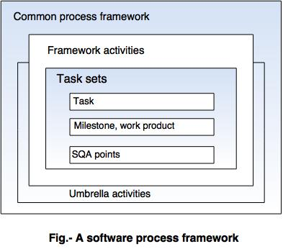
A Process Framework

Slide 15
Framework Activities
Communication
Planning
Modeling
Analysis of requirements
Design
Construction
Code generation
Testing
Deployment

Slide 16
Umbrella Activities
Software project management
Formal technical reviews
Software quality assurance
Software configuration management
Work product preparation and production
Reusability management
Measurement
Risk management

Slide 17
Identifying a Task Set
Before you can proceed with the process model, a key question: what actions are appropriate for a framework activity given the nature of the problem, the characteristics of the people and the stakeholders?
A task set defines the actual work to be done to accomplish the objectives of a software engineering action.
A list of the task to be accomplished
A list of the work products to be produced
A list of the quality assurance filters to be applied

Slide 18
Identifying a Task Set
For example, a small software project requested by one person with simple requirements, the communication activity might encompass little more than a phone all with the stakeholder. The work tasks of this action are:
1. Make contact with stakeholder via telephone.
2. Discuss requirements and take notes.
3. Organize notes into a brief written statement of requirements.
4. E-mail to stakeholder for review and approval.

Slide 19
Software Myths
All people who come into contact with software may suffer from various myths associated with developing and using software. Here are a few common ones.
Affect managers, customers (and other non-technical stakeholders) and practitioners
Are believable because they often have elements of truth, but …
Invariably lead to bad decisions, therefore …
Insist on reality as you navigate your way through software engineering

Slide 20
Management Myths
Myth: The members of an organization can acquire all-the information, they require from a manual, which contains standards, procedures, and principles.
Reality:
1. Standards are often incomplete, inadaptable, and outdated.
2. Developers are often unaware of all the established standards.
3.Developers rarely follow all the known standards because not all the standards tend to decrease the delivery time of software while maintaining its quality.
Myth: If the project is behind schedule, increasing the number of programmers can reduce the time gap.
Reality:
1. Adding more manpower to project, that is behind schedule, further delays the project.
2.New workers take longer to learn about project compared to those already working on the project.

Slide 21
User Myths
Myth: If the project is outsourced to a third party, the management can relax and let the other firm develop software for them.
Reality: Outsourcing software to a third party does not help the organization, which is incompetent in managing and controlling the software project internally. The organization invariably suffers when it out sources the software project.
Myth: Brief requirement stated in the initial process is enough to start development; detailed requirements can be added at the later stages.
Reality:
1.Starting development with incomplete and ambiguous requirements often lead to software failure. Instead, a complete and formal description of requirements is essential before starting development.
2.Adding requirements at a later stage often requires repeating the entire development process.

Slide 22
User Myths
Myth: Software is flexible; hence software requirement changes can be added during any phase of the development process.
Reality: Incorporating change requests earlier in the development process costs lesser than those that occurs at later stages. This is because incorporating changes later may require redesigning and extra resources.

Slide 23
Developer Myths
Myth: Software development is considered complete when the code is delivered.
Reality: 50% to 70% of all the efforts are exhausted after the software is delivered to the user.
Myth: The success of a software project depends on the quality of the product produced.
Reality: The quality of programs is not the only factor that makes the project successful instead the documentation and software configuration also playa crucial role.
Myth: Software engineering requires unnecessary documentation, which slows down the project.
Reality: Software engineering is about creating quality at every level of the software project. Proper documentation enhances quality which results in reducing the amount of rework.

Slide 24
Developer Myths
Myth: The only product that is delivered after the completion of a project is the working program(s).
Reality: The deliverables of a successful project includes not only the working program but also the documentation to guide the users for using the software.
Myth: Software quality can be assessed only after the program is executed.
Reality: The quality of software can be measured during any phase of development process by applying some quality assurance mechanism. One such mechanism is formal technical review that can be effectively used during each phase of development to uncover certain errors.

Slide 25
The Software Engineering Process
A structured set of activities required to develop a software system.
Many different software processes but all involve:
communication
planning
modeling
construction and
deployment
A software process model is an abstract representation of a process. It presents a description of a process from some particular perspective.

Slide 26
Definition of Software Engineering Process
A framework for the activities, actions, and tasks that are required to build high-quality software.
Software Process defines the approach that is taken as software is engineered.
Is not equal to software engineering-which also encompasses technologies that populate the process– technical methods and automated tools.

Slide 27
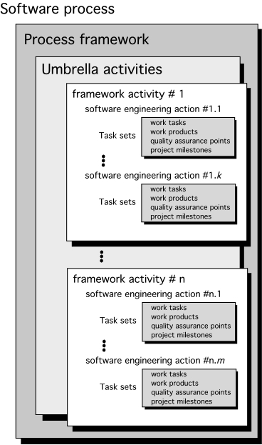
A Generic Process Model

Slide 28
A Generic Process Model
A generic process framework for software engineering defines five framework activities-communication, planning, modeling, construction, and deployment.
In addition, a set of umbrella activities- project tracking and control, risk management, quality assurance, configuration management, technical reviews, and others are applied throughout the process.
Next question is: how the framework activities and the actions and tasks that occur within each activity are organized with respect to sequence and time?

Slide 29
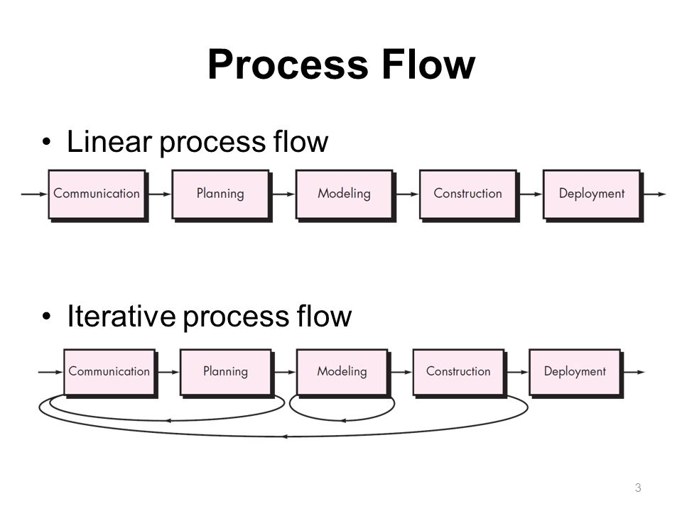
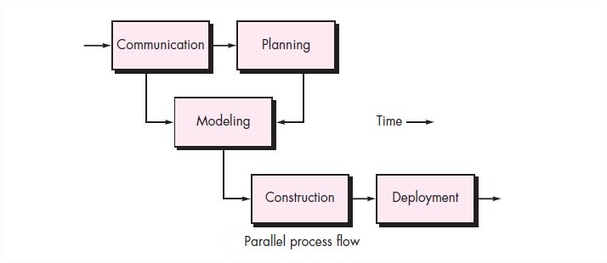
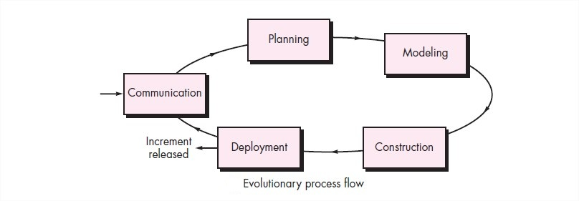
Process Flow

Slide 30
Process Flow
Linear process flow executes each of the five activities in sequence.
An iterative process flow repeats one or more of the activities before proceeding to the next.
An evolutionary process flow executes the activities in a circular manner. Each circuit leads to a more complete version of the software.
A parallel process flow executes one or more activities in parallel with other activities ( modeling for one aspect of the software in parallel with construction of another aspect of the software).

Slide 31
Adapting a Process Model
Depends on :
overall flow of activities, actions, and tasks and the interdependencies among them
the degree to which actions and tasks are defined within each framework activity
the degree to which work products are identified and required
the manner which quality assurance activities are applied
the manner in which project tracking and control activities are applied
the overall degree of detail and rigor with which the process is described
the degree to which customer and other stakeholders are involved with the project
the level of autonomy given to the software team
the degree to which team organization and roles are prescribed

Slide 32
Software Process Models
WATERFALL MODEL
INCREMENTAL PROCESS MODEL
The Incremental Model
The RAD Model
EVOLUTIONARY PROCESS MODELS
Prototyping.
The Spiral model
The Concurrent Development Model
THE UNIFIED PROCESS .
AGILE PROCESS/MODEL

Slide 33
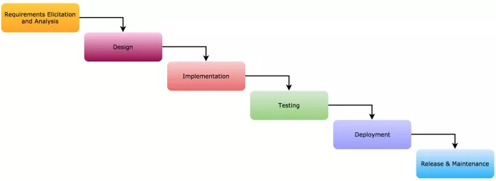
i. The Waterfall Model

Slide 34
The Waterfall Model
1) Requirement Gathering and analysis: Here requirements of the system or project that is to be developed are captured from client and all these requirements are documented in a requirement specification document to prepare a SRS. This SRS is verify by the client and after acceptance next phase begins.
2) System Design: Here a design of the system is prepared. Plan system hardware and software requirements. It helps in defining the overall system architecture.
3)Implementation: Once the design of a system is prepared, the system is broken into small programs called units, which are integrated in the next phase. In this phase the software is coded and simple unit testing is performed.

Slide 35
The Waterfall Model
4)Testing: After testing all the units are integrated into a system and system testing is performed. This is used to find any bugs or failure in the system or to verify that system is built as per the requirements of client.
5)Deployment: Once the testing phase is done, the product or software is deployed or installed in the customer environment.
6)Maintenance: Maintenance is required to fix the issues and to release improved versions to enhance the product.

Slide 36
The Waterfall Model
Advantages:
Model is simple, easy to understand.
Waterfall model is useful for smaller projects and it gives an appropriate result.
System Requirements are documented and understood by projects team members
Each phase works independently and do not overlap the other phases.
Customer interaction is only at in the beginning and at the last phase of the project.
Notes:
Example: let as take a Example of making a website of 7 pages for any shop. this is a small website which is developed using waterfall model and it require less time to developed .
1) Requirement Gathering and analysis : All the client requirements about the website is gathered and prepare a SRS document. Requirements like their is one registration page, one login page, user profile page, products view page, product buy, add to cart , Billing. All the requirements are clear,documented and well understood.
2) System Design : what type of programming language php,java or .net or what type of database is used to develop the website is planned in this phase.
3) Implementation : Once the programming language is finalized the coding is begin in the Implementation phase and small units are prepare like all the pages are coding one by one.
4) Testing: All the pages are integrated or linking with each other and performing system testing to check the functionality of the website it is according to the customer requirement or not.
5) Deployment:Once the website is completed it is deployed in the customer system for the acceptance .
6) Maintenance: If any issue is come after deploying the website then patches are released to resolve those issues.

Slide 37
The Waterfall Model
Problems/Disadvantages:
This model is not desirable for complex and bigger project where requirement changes frequently and risk factor is higher.
This model also not good for ongoing projects.
Customer interaction is less and it cannot adopt the changes in system requirements.
This model requires more documentation which is not suitable for big projects.
Customer feedback only at the end of the product.
Small change makes lot of problems in the development

Slide 38
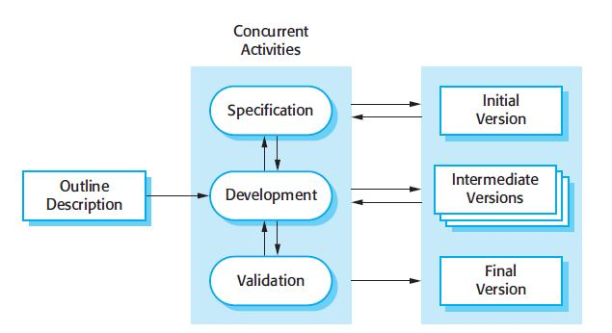
ii. Incremental Development

Slide 39
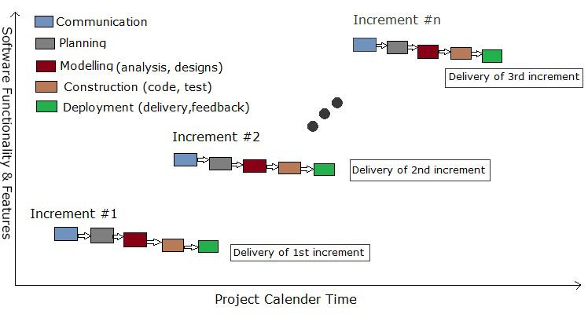
The Incremental Model

Slide 40
Incremental model
The incremental model applies the waterfall model incrementally.
The series of releases is referred to as “increments”, each increment providing more functionality to the customers.
The product is defined as finished only when it satisfies all of its requirements.
It involves both development and maintenance.
After the first increment, a core product is delivered, which can already be used by the customer. Based on customer feedback, a plan is developed for the next increments, and modifications are made accordingly.
The incremental philosophy is also used in the agile process model.

Slide 41
Incremental model: Characteristics
Characteristics of Incremental Model
System is broken down into many mini development projects.
Partial systems are built to produce the final system.
First tackled highest priority requirements.
The requirement of a portion is frozen once the incremented portion is developed.
Tasks involved:
Communication: helps to understand the objective.
Planning: required as many people (software teams) work on the same project but different function at same time.
Modeling: involves business modeling, data modeling, and process modeling.
Construction: this involves the reuse software components and automatic code.
Deployment: integration of all the increments

Slide 42
Advantages & Disadvantages
Advantages of Incremental model:
i ) Generates working software quickly and early during the software life cycle.
ii ) This model is more flexible – less costly to change scope and requirements.
iii ) It is easier to test and debug during a smaller iteration.
iv ) In this model customer can respond to each built.
v ) Lowers initial delivery cost.
Disadvantages of Incremental model:
i ) Needs good planning and design.
ii ) Needs a clear and complete definition of the whole system before it can be broken
down and built incrementally.
iii ) Total cost is higher than other traditional model

Slide 43
When to use Incremental Model ?
When the requirements of the complete system are clearly defined and understood.
Major requirements are defined; however, some details can evolve with time.
There is a need to get a product to the market early.
A new technology is being used
Resources with needed skill set are not available
There are some high risk features and goals.

Slide 44
iii. RAD Model
RAD is a Rapid Application Development model.
Using the RAD model, software product is developed in a short period of time.
The initial activity starts with the communication between customer and developer.
Planning depends upon the initial requirements and then the requirements are divided into groups.
Planning is more important to work together on different modules
Rapid application development emphasizes working software and user feedback over strict planning and requirements recording.

Slide 45
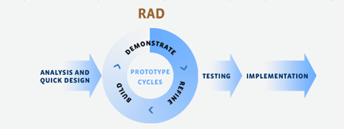
RAD Model

Slide 46
RAD Model
1. Figure out the requirements : Identify why the software or app is built and what the project is supposed to accomplish.
Involve users, developers, and designers to discuss the purpose of the system and a estimated project timeline. The budget is a strong constraint.
2. Build prototypes: Team will start working on building functional models right away. The engineers and designers will create and improve upon working prototypes
3. Get user feedback :
RAD calls for ongoing collaboration between your team and users in order to create a high-quality system. The users will be the ones providing feedback to improve your prototypes.

Slide 47
A general model of the design process
4. Do it again : Repeat steps two and three until you feel like your project is done or until you have all working parts assembled together to meet a client’s requirements.
5. Test, test, test :
Run the system through different scenarios and make sure it accomplishes the system’s goal.

Slide 48
RAD Model
Advantages of RAD Model
For developing a large, complicated software, it helps to form more specialized teams.
The process of application development and delivery are fast.
This model is flexible, if any changes are required.
Reviews are taken from the clients at the staring of the development hence there are lesser chances to miss the requirements.
Always having something to show your client means you can get their feedback and quickly implement any changes
Disadvantages of RAD Model
The feedback from the user is required at every development phase.
This model is not a good choice for long term and large projects.

Slide 49
When is RAD useful?
When a quick delivery of a product is needed for a customer.
When there are going to be changes made to the prototype throughout the process before the final product is completed.
When there are plenty of knowledgeable developers and engineers on hand and the customer must also remain committed to the process and the schedule.
When either of these two components is not available, the RAD formula can fail.
Eg. In the investment banking (IB) industry, most notably when applied to trading systems

Slide 50
IV. Prototyping Model
Communication: Developer and customer meet and discuss the overall objectives 2. Quick design
Quick design is implemented when requirements are known.
It includes only the important aspects like input and output format of the software and focusses on those aspects which are visible to the user rather than the detailed plan.
It helps to construct a prototype.
3. Modeling quick design
This phase gives the clear idea about the development of software
It allows the developer to better understand the exact requirements.
4. Construction of prototype
The prototype is evaluated by the customer itself.
5. Deployment, delivery, feedback
If the user is not satisfied then it refines according to the requirements of the user.
The process of refining the prototype is repeated until all the requirements of users are met.
When the users are satisfied with the developed prototype then the system is developed on the basis of final prototype.

Slide 51
Prototyping Model
Advantages of Prototyping Model
Prototype model need not know the detailed input, output, processes, adaptability of operating system and full machine interaction.
In the development process of this model users are actively involved.
The development process is the best platform to understand the system by the user.
Errors are detected much earlier.
Gives quick user feedback for better solutions.
It identifies the missing functionality easily and identifies confusing or difficult functions.
Disadvantages of Prototyping Model:
The client involvement is more and it is not always considered by the developer.
It is a slow process because it takes more time for development.
Many changes can disturb the rhythm of the development team.
It is a thrown away prototype when the users are confused with it.

Slide 52
Prototype vrs Incremental Model
Prototype Model: Instead of freezing the requirements before a design or coding can proceed, a throwaway prototype is built to understand the requirements.
Incremental model : the whole requirement is divided into various builds. Multiple development cycles take place here, making the life cycle a “multi-waterfall” cycle. Cycles are divided up into smaller, more easily managed modules.

Slide 53
v. Spiral Model
Spiral model is a risk driven process model -which means that the overall success of a project highly depends on the risks analysis phase.
Requires skills and expertise.
It is used for generating the large software projects.
In spiral model, an alternate solution is provided if the risk is found in the risk analysis, then alternate solutions are suggested and implemented.
It is a combination of prototype and sequential model or waterfall model.
In one iteration all activities are done, for large project's the output is small.
Turns out costlier

Slide 54
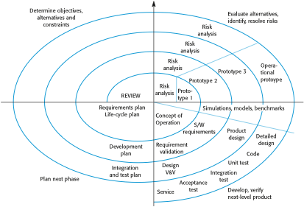
Boehm’s Spiral Model

Slide 55
Stages in Spiral Model
Spiral Lifecycle Model was initiated by Boehm and is used while working with high risk projects.
Features are combination of waterfall model and prototype model and activities executed in the form of a spiral.
The entire project goes through the 4 stages now and then through each iteration known as a spiral.
Stage 1: Identification
Starts with gathering the requirements , Identifications of system and sub-system with continuous communication.
As soon as this spiral is accomplished, the project is deployed into the identified phase.
Stage 2: Design
Basics of design in the baseline spiral which includes architectural, logical and physical design of the product.
Stage 3: Construct
Build stage includes the construction of the existing product at each spiral.
At that point in the resulting spirals, a model of the product with version number – “Build” is created. These builds are further sent to client for input for checking Proof of Concept
Stage 4: Assessment and Risk Analysis
This model undergoes through the process of identifying, monitoring technical feasibility, estimation and risk management. Eg. such as schedule slippage and cost overrun.

Slide 56
Spiral model
Advantages of Spiral Model
It reduces high amount of risk.
It is good for large and critical projects.
It gives strong approval and documentation control.
In spiral model, the software is produced early in the life cycle process.
Disadvantages of Spiral Model
It can be costly to develop a software model.
It is not used for small projects.

Slide 57
vi. The Unified Process
A modern generic process derived from the work on the (Unified Modelling Language) UML and associated process.
Brings together aspects of the 3 generic process models discussed previously.
The UP recognizes that conventional process models present a single view of the process. In contrast, the UP is normally described from three perspectives:
A dynamic perspective, which shows the phases of the model over time.
A static perspective, which shows the process activities that are enacted.
A practice perspective, which suggests good practices to be used during the process.

Slide 58
Dynamic Perspective
The UP is a phased model that identifies four discrete phases in the software process. The phases in UP are more closely related to business rather than technical concerns.
Iteration within the UP is supported in two ways. Each phase may be enacted in an iterative way with the results developed incrementally.
In addition, the whole set of phases may also be enacted incrementally, as shown by the looping arrow from Transition to Inception in the above diagram.

Slide 59
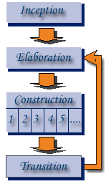
Phases in the Unified Process (Cont...)

Slide 60
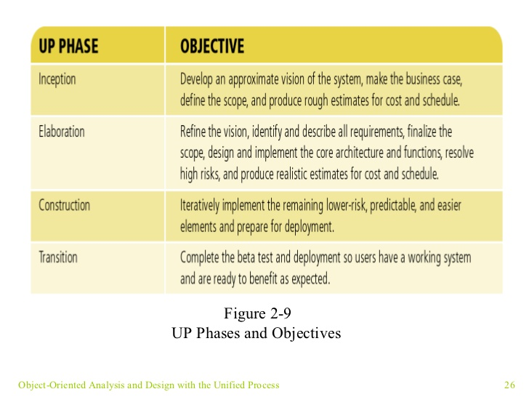
Unified Process Work Products

Slide 61
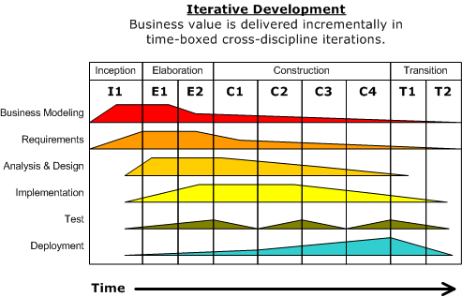
Phases in the Unified Process (Cont...)

Slide 62
Static workflows in the Unified Process
This focuses on activities that take place during the development process – and called workflows
There are six core process workflows identified in the process and three core supporting workflows.
Workflow | Description
Business modelling | The business processes are modelled using business use cases.
Requirements | Actors who interact with the system are identified and use cases are developed to model the system requirements.
Analysis and design | A design model is created and documented using architectural models, component models, object models and sequence models.
Implementation | The components in the system are implemented and structured into implementation sub-systems. Automatic code generation from design models helps accelerate this process.

Slide 63
Static workflows in the Unified Process
Workflow | Description
Testing | Testing is an iterative process that is carried out in conjunction with implementation. System testing follows the completion of the implementation.
Deployment | A product release is created, distributed to users and installed in their workplace.
Configuration and change management | This supporting workflow managed changes to the system
Project management | This supporting workflow manages the system development
Environment | This workflow is concerned with making appropriate software tools available to the software development team.

Slide 64
Unified Process good practice
Develop software iteratively : Plan increments based on customer priorities and deliver highest priority increments first.
Manage requirements :Explicitly document customer requirements and keep track of changes to these requirements.
Use component-based architectures :Organize the system architecture as a set of reusable components.
Visually model software : Use graphical UML models to present static and dynamic views of the software.
Verify software quality: Ensure that the software meet’s organizational quality standards.
Control changes to software :Manage software changes using a change management system and configuration management tools.

Slide 65
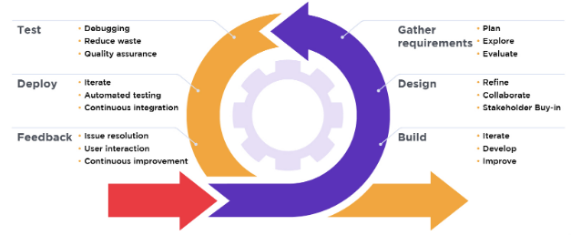
vii. The Agile Model
Agile Model

Slide 66
Agility
Effective (rapid and adaptive) response to change (team members, new technology, requirements)
Effective communication in structure and attitudes among all team members, technological and business people, software engineers and managers
Drawing the customer into the team. Eliminate “us and them” attitude. Planning in an uncertain world has its limits and plan must be flexible.
Organizing a team so that it is in control of the work performed
Eliminate all but the most essential work products and keep them lean.
Emphasize an incremental delivery strategy as opposed to intermediate products that gets working software to the customer as rapidly as feasible.

Slide 67
Agile Process/Model
Is driven by customer descriptions of what is required (scenarios).
Some assumptions:
Recognizes that plans are short-lived(some requirements will persist, some will change, Customer priorities will change)
Develops software iteratively with a heavy emphasis on construction activities (design and construction are interleaved, hard to say how much design is necessary before construction. Design models are proven as they are created. )
Analysis, design, construction and testing are not predictable.
Thus has to Adapt as changes occur due to unpredictability
Delivers multiple ‘software increments’, deliver an operational prototype or portion of an OS to collect customer feedback for adaption.

Slide 68
Agile Process/Model
1. Our highest priority is to satisfy the customer through early and continuous delivery of valuable software.
2. Welcome changing requirements, even late in development. Agile processes harness change for the customer's competitive advantage.
3. Deliver working software frequently, from a couple of weeks to a couple of months, with a preference to the shorter timescale.
4. Business people and developers must work together daily throughout the project.
5. Build projects around motivated individuals. Give them the environment and support they need, and trust them to get the job done.
6. The most efficient and effective method of conveying information to and within a development team is face–to–face conversation.

Slide 69
Agile Process/Model
7. Working software is the primary measure of progress.
8. Agile processes promote sustainable development. The sponsors, developers, and users should be able to maintain a constant pace indefinitely.
9. Continuous attention to technical excellence and good design enhances agility.
10. Simplicity – the art of maximizing the amount of work not done – is essential.
11. The best architectures, requirements, and designs emerge from self–organizing teams.
12. At regular intervals, the team reflects on how to become more effective, then tunes and adjusts its behavior accordingly.

Slide 70
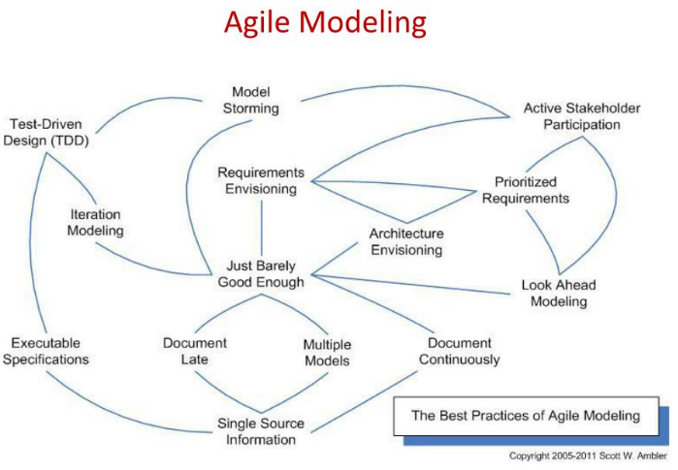
https://image1.slideserve.com/1584785/slide27-l.jpg

Slide 71
Other Process Models
Component based development—the process to apply when reuse is a development objective ( like spiral model)
Formal methods—emphasizes the mathematical specification of requirements ( easy to discover and eliminate ambiguity, incompleteness and inconsistency)
Aspect Oriented software development (AOSD)—provides a process and methodological approach for defining, specifying, designing, and constructing aspects

Slide 72
How to choose an appropriate process model?
Characteristics of the software to be developed: . for product and embedded development, the Iterative Waterfall model can be preferred. The evolutionary model is suitable to develop an object-oriented project. User interface part of the project is mainly developed through prototyping model.
Characteristics of the development team: If the development team is experienced in developing similar software, then even an embedded software can be developed using the Iterative Waterfall model. If the development team is entirely novice, then even a simple application may require a prototyping model.
Risk associated with the project: If the risks are few and can be anticipated at the start of the project, then prototyping model is useful. If the risks are difficult to determine at the beginning of the project but are likely to increase as the development proceeds, then the spiral model is the best model to use.
Characteristics of the customer: If the customer is not quite familiar with computers, then the requirements are likely to change frequently as it would be difficult to form complete, consistent and unambiguous requirements. Thus, a prototyping model may be necessary to reduce later change requests from the customers.
the evolutionary model is useful as the customer can experience a partially working software much and reduces the customer’s trauma of getting used to an entirely new system.

Slide 73
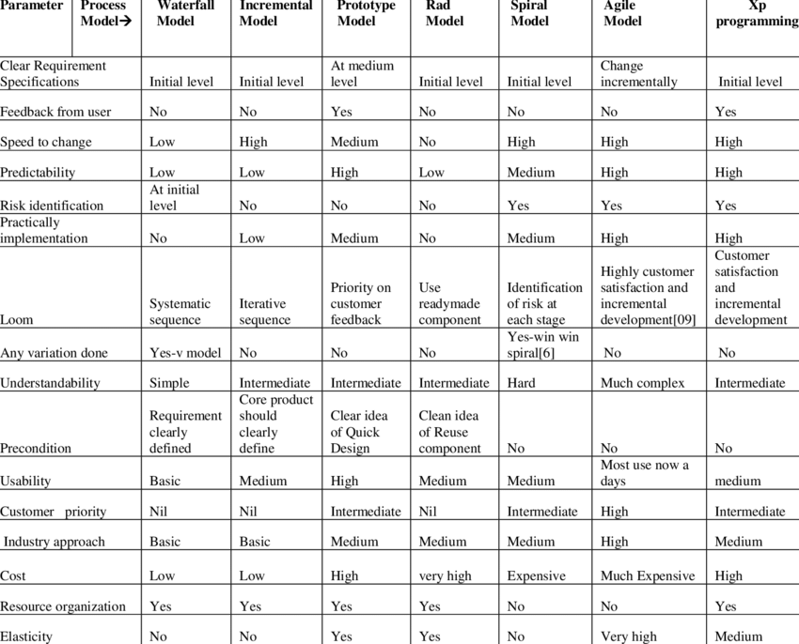
Comparison

Slide 74
How to choose an appropriate Process Model ?
Some key points to consider :
observing the domain problem at hand,
the amount of resources available to solve the problem (time, intellectual capital and money could help),
the Culture of the organization being served,
Assess the needs of Stakeholders

Slide 75
Choosing an appropriate Process Model
Factors | Waterfall | V-Shaped | Evolutionary Prototyping | Spiral | Iterative and Incremental | Agile
Unclear User Requirement | Poor | Poor | Good | Excellent | Good | Excellent
Unfamiliar Technology | Poor | Poor | Excellent | Excellent | Good | Poor
Complex System | Good | Good | Excellent | Excellent | Good | Poor
Reliable system | Good | Good | Poor | Excellent | Good | Good
Short Time Schedule | Poor | Poor | Good | Poor | Excellent | Excellent
Strong Project Management | Excellent | Excellent | Excellent | Excellent | Excellent | Excellent
Cost limitation | Poor | Poor | Poor | Poor | Excellent | Excellent
Visibility of Stakeholders | Good | Good | Excellent | Excellent | Good | Excellent
Skills limitation | Good | Good | Poor | Poor | Good | Poor
Documentation | Excellent | Excellent | Good | Good | Excellent | Poor
Component reusability | Excellent | Excellent | Poor | Poor | Excellent | Poor

Slide 76
Summary
Process is a means to achieve project objectives of high Quality
Software process models are abstract representations of these processes
Process models define generic process, which can form basis of project process
Process typically has stages, each stage focusing on an identifiable task
Many models for development process have been proposed
Waterfall model, Evolutionary development and component-based software Engineering, Iterative process models are some process model.
The Rational Unified Process is a generic process model that separates activities from phases
A prototype can be used to give end-users a concrete impression of the system’s capabilities

Slide 77
Requirement Engineering

Slide 78
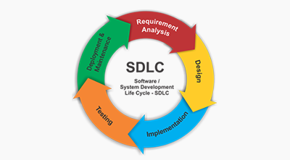
Software Development Life Cycle

Slide 79
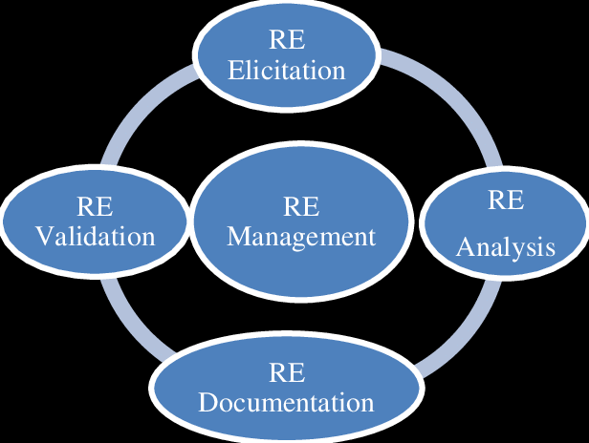
The Requirement Engineering
Requirements engineering is a process of gathering and defining of what the services should be provided by the system.

Slide 80
What is Requirements Engineering?
Requirements are description of features and functionalities of the system and convey the expectations of users from the software product.
Requirements engineering refers to the process of defining, documenting and maintaining requirements in the engineering design process.
It is a common role in systems engineering and software engineering.
The requirements can be obvious or hidden, known or unknown, expected or unexpected from client’s point of view.

Slide 81
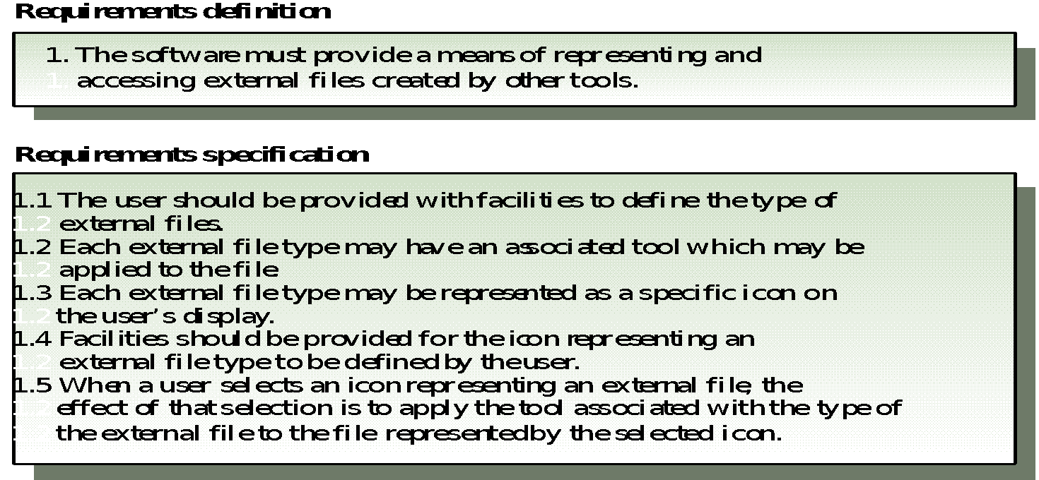
Requirement Definitions and Specifications Example

Slide 82
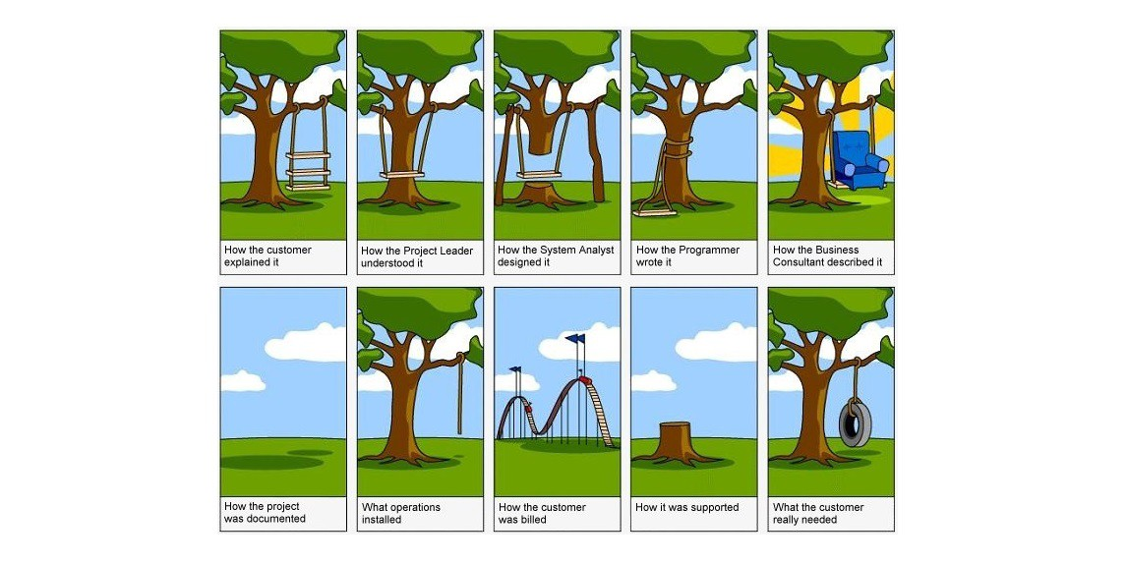
Ugly Face of Requirement Engineering

Slide 83
Requirement Engineering Steps
RE has overlapping steps :
Inception - in which the nature and scope of the system is defined.
Elicitation - in which the requirements for the software are initially gathered.
Elaboration - in which the gathered requirements are refined.
Negotiation -in which the priorities of each requirement is determined, the essential requirements are noted, and, conflicts between requirements are resolved.
Specification - in which the requirements are gathered into a single product, being the result of the requirements engineering.
Validation - in which the quality of the requirements (i.e., are they unambiguous, consistent, complete, etc.), and the developer's interpretation of them, are assessed.
Management - in which the changes that the requirements must undergo during the project's lifetime are managed.

Slide 84
Requirements Engineering Steps
Inception— Ask a set of questions that establish …
Basic understanding of the problem
The nature of the solution that is desired
The effectiveness of preliminary communication and collaboration between the customer and the developer
The people who want a solution -Identify Stakeholders : Stakeholders can affect or be affected by the application’s actions, objectives and policies. End Users, Build Team and Authorities
Recognize multiple points of view

Slide 85
Requirements Engineering- Steps
Elicitation
Elicit requirements , identify problems from all stakeholders
Propose elements of the solution
The scope and negotiate different approaches,,
Understanding of the problem and volatility (requirements change over time )
Specify a preliminary set of solution requirements

Slide 86
Requirements Engineering- Steps
Elaboration
Create an analysis model that identifies data, function and behavioral requirements.
It is driven by the creation and refinement of user scenarios that describe how the end-user will act with the system.

Slide 87
Requirements Engineering- Steps
Negotiation
Identify Conflicting Requirements and reconcile these conflicts through a process of negotiation.
Stakeholders are asked to rank requirements and then discuss conflicts in priority.
Risks in each requirement are identified and analyzed.
Agree on a deliverable system that is realistic for developers and customers.
Specification : SRS or a prototype
It is the final work produced by the RE. It is serves as the foundation for subsequent S.E. activities.

Slide 88
Validation
A review mechanism that looks for
Errors in content or interpretation
Areas where clarification may be required
Missing information
Inconsistencies (a major problem when large products or systems are engineered)
Conflicting or unrealistic (unachievable) requirements.
Management
Set of activities that help the project team identify, control, and track requirements and changes to requirements at any time as the project proceeds.

Slide 89
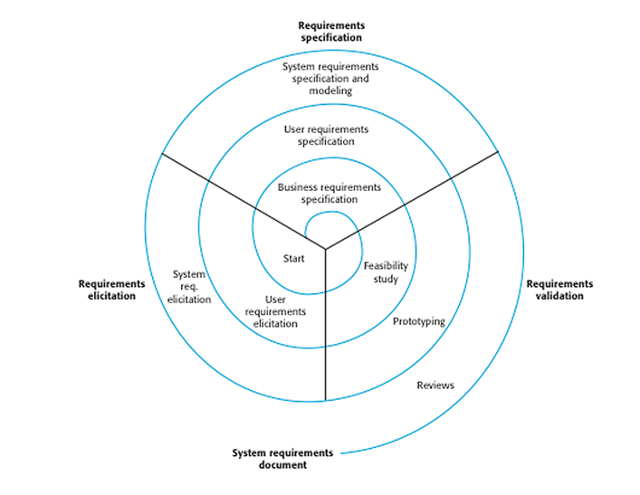
The process of requirements engineering

Slide 90
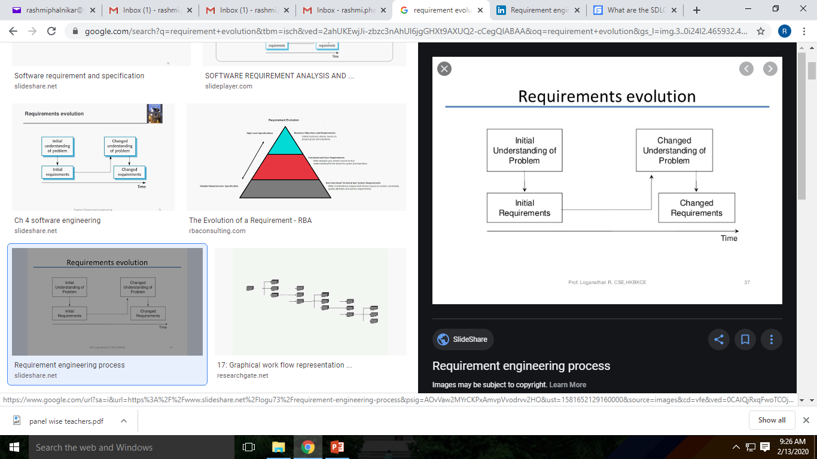
Requirements Evolution

Slide 91
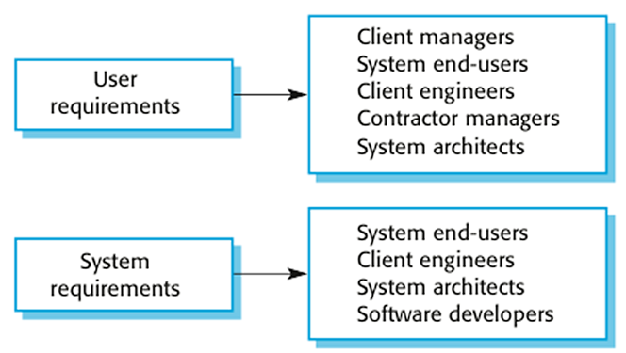
User and System Requirements
User need a high-level statements of the requirements, while system developers need a more detailed system specification.
Having different level of details is useful because it communicates information about the system being developed for different types of readers.

Slide 92
User and System Requirements
User Requirements : describes the services that the system should provide and the constrains under which it must operate.
more of generic requirements and Readable by everybody
Services and constraints of the system
In natural language or diagrams
Serve business objectives
System Requirements : gives a more detailed description of the system services and the operational constrains (how system will be used, programming languages etc)
This level of detail is needed by those who are involved in the system development
Useful for the design and development
Precise and cover all cases
Structured presentation

Slide 93
Example
User requirement: The library system should provide a way to allow a patron to borrow a book from the library.
System requirement: The library system should provide a withdraw interaction that allows a patron to withdraw a book given the isbn and copy number of the book to be withdrawn. The interaction fails if: the book is already withdrawn, the book is not in the library's collection, the patron has already withdrawn 5 books, the book is on hold by someone else.
Software Specification: A detailed software description which can serve as a basis for a design or implementation. Written for developers

Slide 94
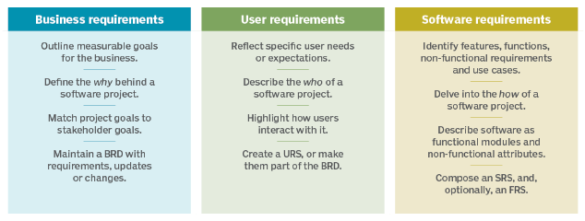

Slide 95
RE Process
Requirement Engineering is the process of defining, documenting and maintaining the requirements.
A process of gathering and defining service provided by the system.
It ensures your software will meet the user expectations, and ending up with a high quality software.
It’s a critical stage of the software process as errors at this stage will reflect later on the next stages, which definitely will cause you a higher costs.
At the end of this stage an SRS is produced and validated with the stakeholders.

Slide 96
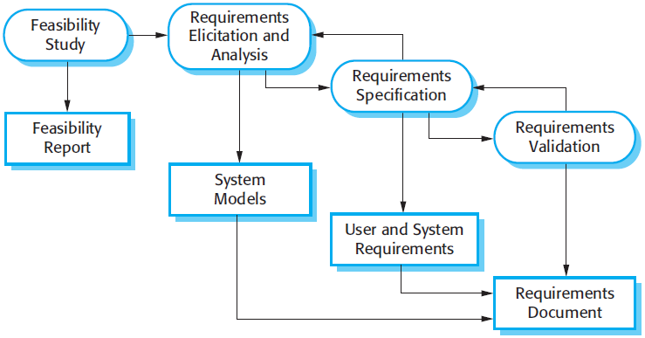
The RE process

Slide 97
RE Process
Feasibility study:
Check is made if the identified can be achieved using the given conditions
This step should be cheap and quick;
Requirements elicitation and analysis:
Deriving the system requirements through observation of existing systems, discussions with stakeholders, etc.
Can involve development of a system models and prototypes to understand the specified system
Requirements specification:
It’s the activity of writing down the information gathered during the elicitation and analysis activity into a document that defines a set of requirements.
Two types of requirements may be included in this document; user and system requirements.
Requirements validation:
It’s the process of checking the requirements for realism, consistency and completeness.
Goal is to discover errors in the requirements document.
When errors are found, it must be modified to correct these problems.

Slide 98
Types of Requirements
Functional requirements
Services the system should provide
What the system should do or not in reaction to particular situations
Non-functional requirements
Constraints on the services or functions offered by the system
Examples: Timing constraints, constraints on the development process (CASE, language, development method…), standards etc
Domain requirements
From the application domain of the system
May be functional or non-functional
Examples: Medicine, library, physics, chemistry

Slide 99
Bad Requirements
Missing Requirements –A functionality that is totally missing from the documentation.
“Error messaging” in case of data validation
not detailing the need for a certain link available as per the access rules on an application.
Conflicting Requirements – When two or more requirements expect the system to do different things that can’t possibly be done at the same time.
the business stakeholder might want to retrieve a 1000 records at a time in real-time whereas the technology stakeholder knows this is practically impossible and not feasible.
Incomplete/Unclear Requirements – Requirements that lack all the necessary information constitute this lot.
“The system should have the capability to filter search results”. The details around filter criteria is not been provided and thus raises unnecessary queries.
Ambiguous Requirements – A requirement statement that can be interpreted in different ways by different people.

Slide 100
Ambiguous Requirements
A client needed to be able to upload "large files." A solution was found where the platform could handle the "large files." Client was assured a solution was found and testing began. Client gave a feedback that the solution was not meeting their needs, was freezing and full of bugs.
To the client "large" meant 20-50GB and to our team and the platform provider "large" meant up to 5GB.
Trigger an automatic log out when a user attempts to download up to 5 times. Display is up to large screen size.
Is this 5 times including the 5th time or 4 times?
the page has a document that is in 5 parts
For the screen size, 720px may be large for some and 1280 may be large for some.

Slide 101
Requirements Checking
Validity. Does the system provide the functions which best support the customer’s needs?
Consistency. Are there any requirements conflicts?
Completeness. Are all functions required by the customer included?
Realism. Can the requirements be implemented given available budget and technology
Verifiability. Can the requirements be checked?

Slide 102
Requirements: Functional
Functional requirements:
Depend on the system, the software, and the users
Can be expressed at different levels of detail (user/system requirements)
For a system, it is desirable to have a complete and consistent set of functional requirements
Completeness: all required system facilities are defined
Consistency: there are no contradictions in requirements

Slide 103
Requirements: Non-functional
Non-functional requirements:
Many apply to the system as a whole
More critical than individual functional requirements
More difficult to verify
Kinds of non-functional requirements:
Product requirements
Organizational requirements
External requirements

Slide 104
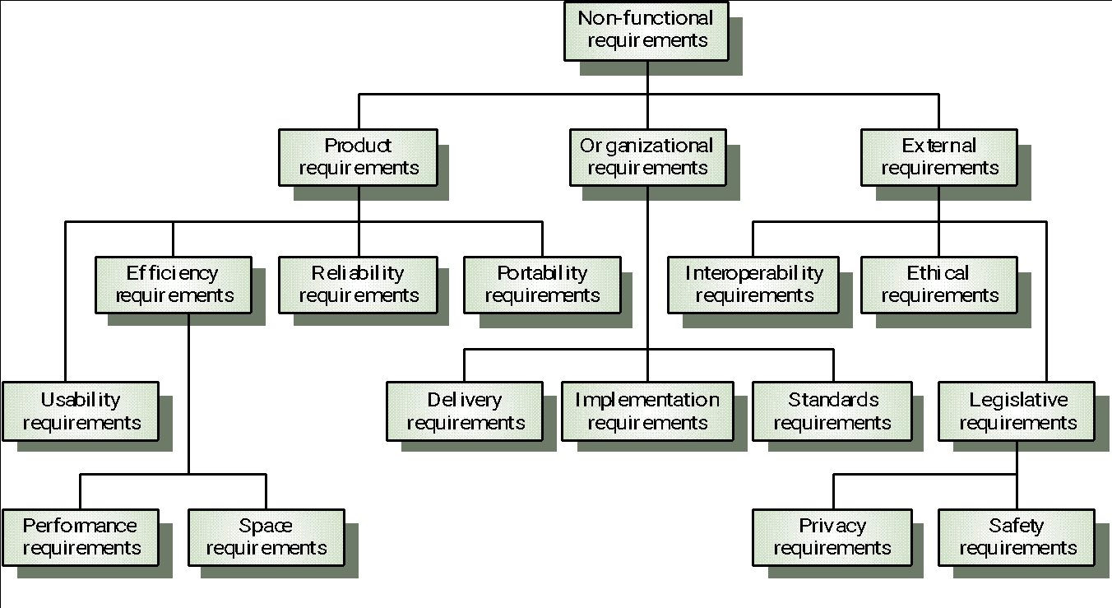
Requirements: Non-functional
A classification of non-functional requirements:

Slide 105
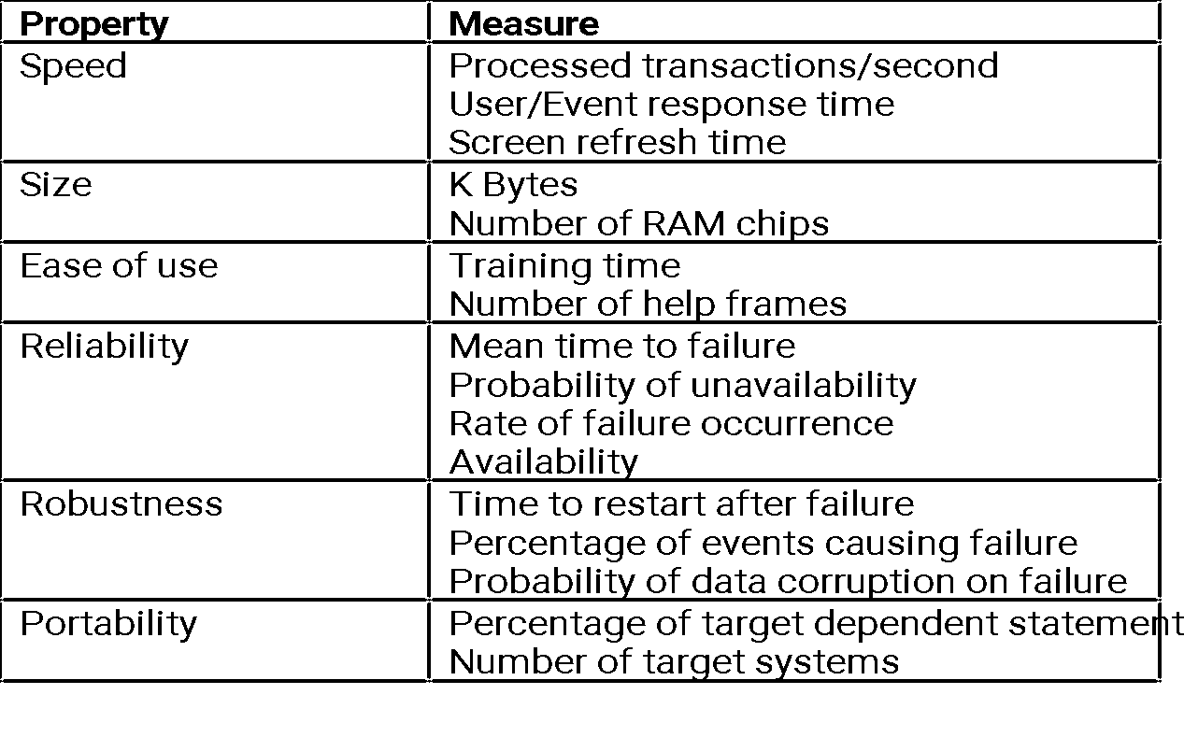
Requirements: Non-functional
Metrics that can be used to quantitatively specify and verify non-functional requirements

Slide 106
References
Roger S Pressman, Software Engineering: A Practitioner’s Approach, Mcgraw-Hill, ISBN: 0073375977, Seventh Edition, 2014
Ian Sommerville, ― Software Engineering‖, Addison and Wesley. 9th Ed., 2011.
Pankaj Jalote, Software Engineering: A Precise Approach, Wiley India.2010.
Disclaimer:
Information included in this slides came from multiple sources. We have tried our best to cite the sources. Please refer to the References to learn about the sources, when applicable.
The slides should be used only for academic purposes (e.g., in teaching a class), and should not be used for commercial purposes.

